Slide 1
Virtual Reality Escape Room to teach concepts of Computer Science
University of Brighton
James Shaw, John Vos, Jack Whitchurch, Ross Jones

Slide 2
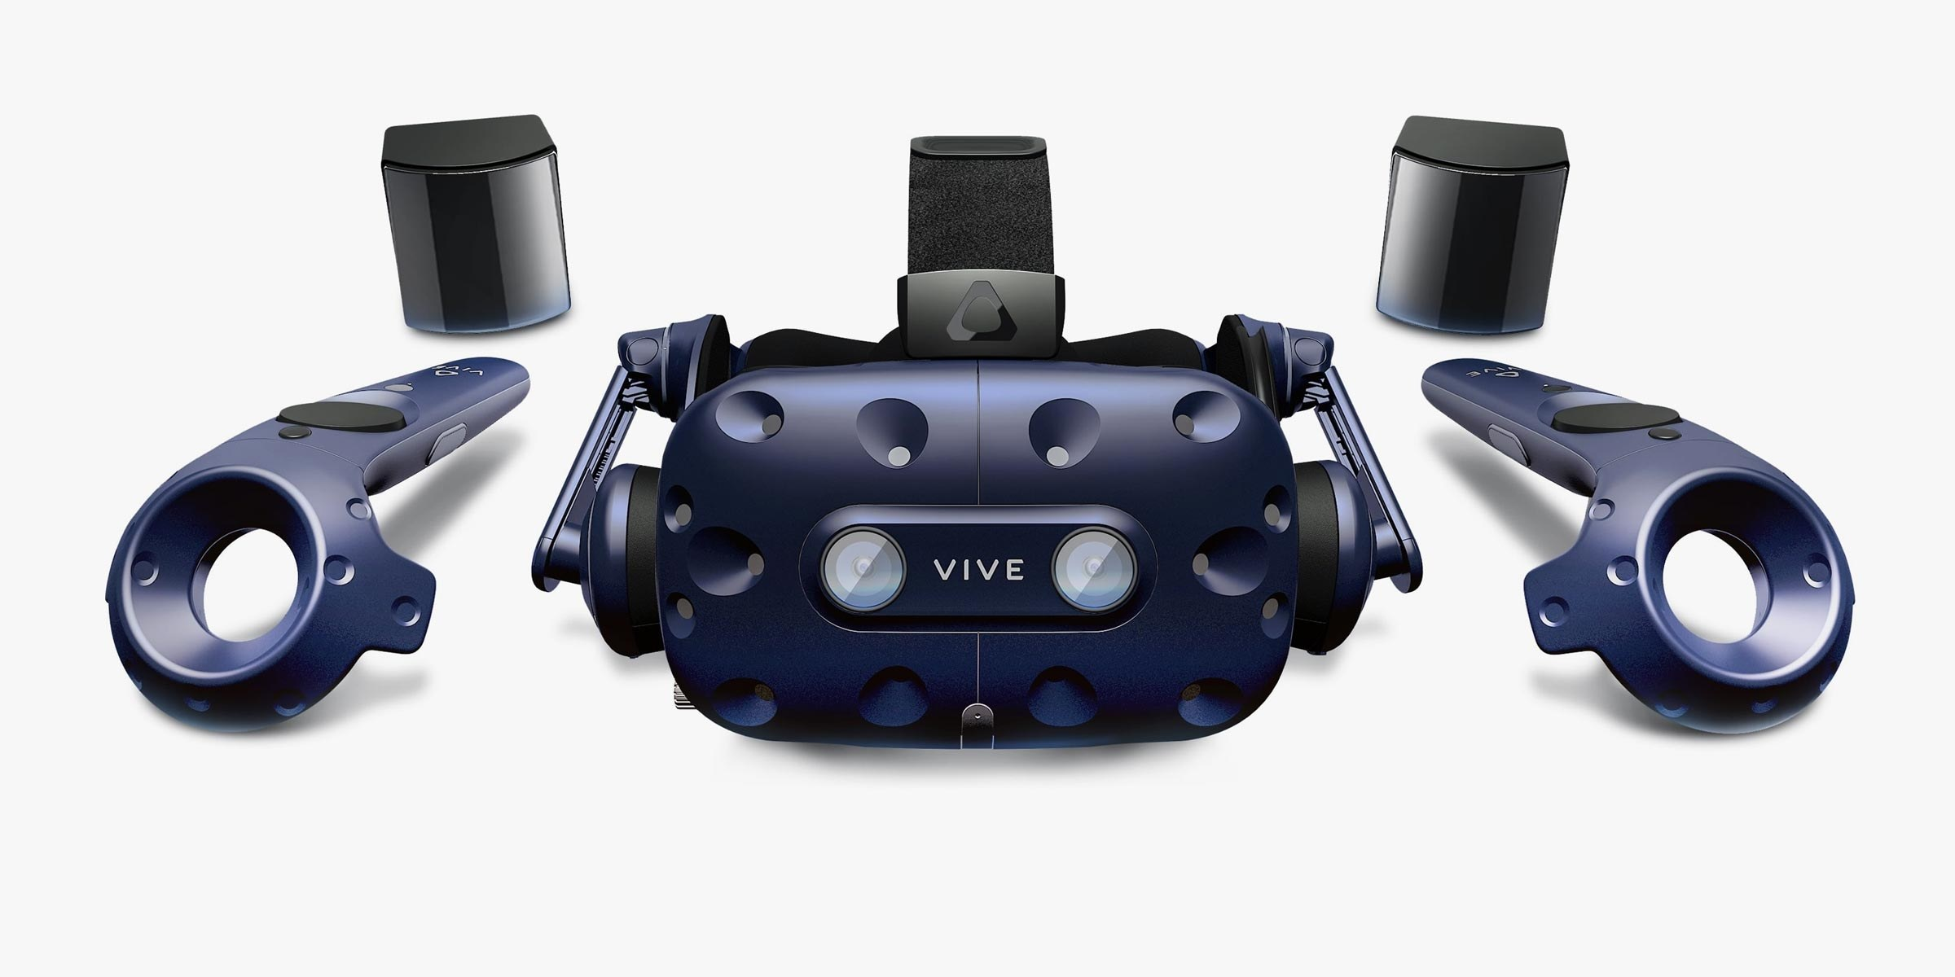
Why we chose VR:
Notes:
We wanted a challenge – wanted to learn new skills etc
It’s more interactive - can be hard to keep children’s attention
Plenty of websites and apps already available for education – this is the next step

Slide 3

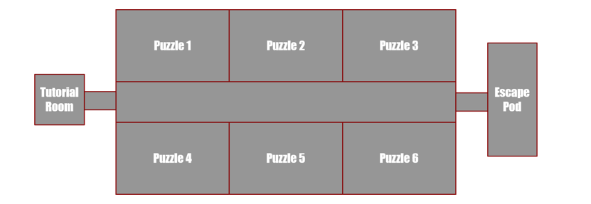
Our Concept:
Notes:
Low level programming – Easy for kids to understand and a good welcome into the vast world of programming.
Child friendly theme – space is something most kids are interested in, which this theme is likely to keep them engaged.

Slide 4
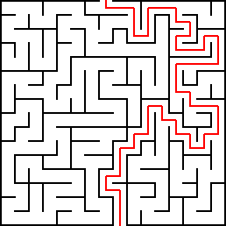
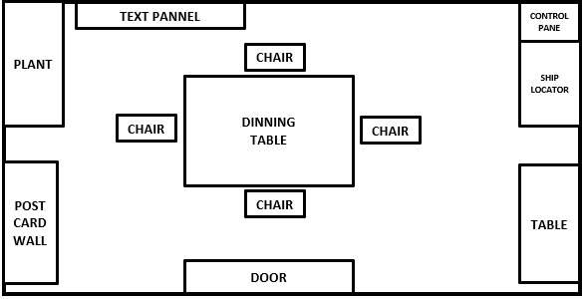
What is an escape room:
Notes:
Themed room
Have to completes a mission and ‘escape’ within a time limit
Have to find a combination of codes, find various keys and think out of the box in order to succeed

Slide 5
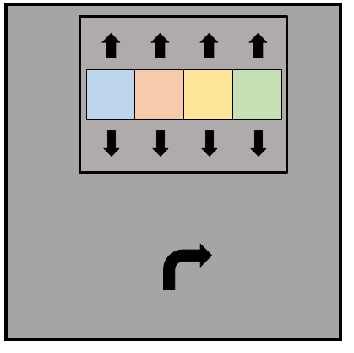
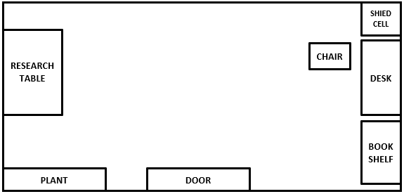
Why we chose an escape room:
Notes:
Have the potential to turn into group learning – could have multiple people in game
They’re fun, popular, engaging
Active learning – Users aren’t just reading and clicking – they’re learning through doing!

Slide 6


Market Research:
Notes:
Making escape rooms – how to make one, is it feasible for us to do? Why we chose unity.
Seeing what other products are available – has anyone else done our idea?

Slide 7


Software Used:
Notes:
Thnx 4 the pastries

Slide 8
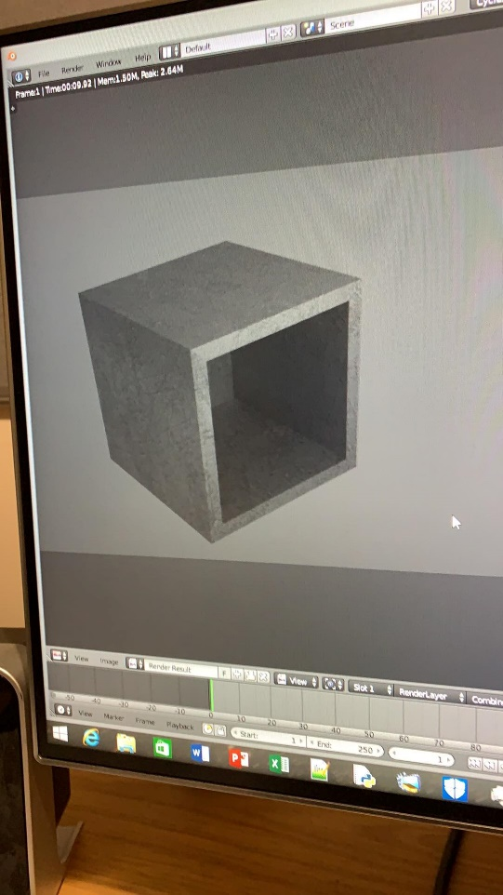
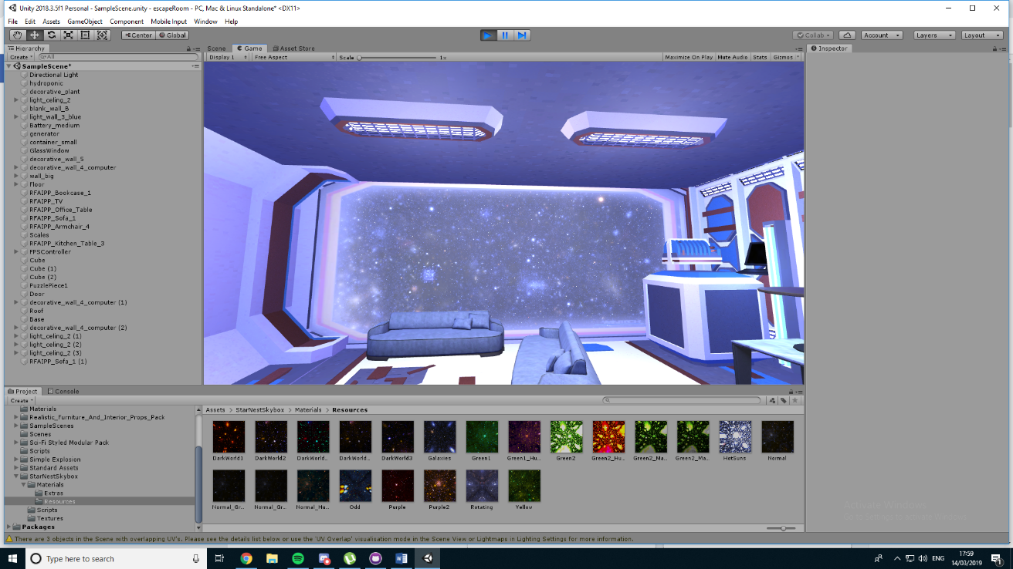
Development Process:
Notes:
How we used agile – how we planned our project dynamically weekly meetings, comparing weekly progress.
Software model planning – case diagrams, class diagrams, model drafts.
Blender & Unity
VR

Slide 9
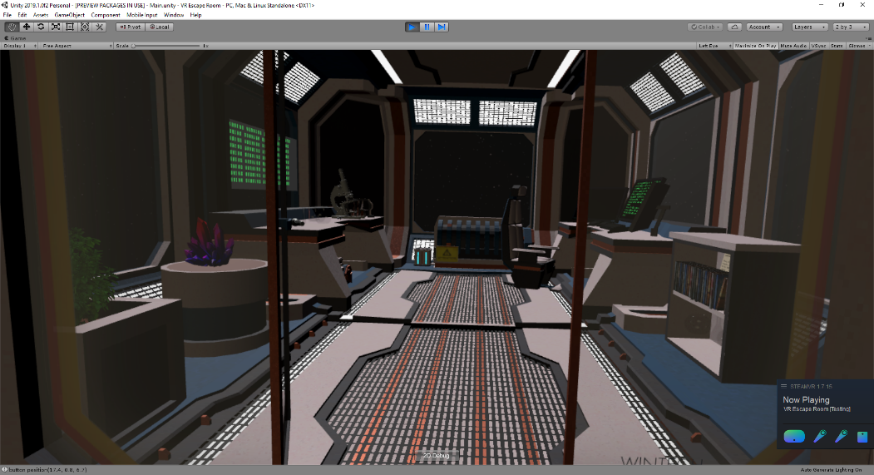
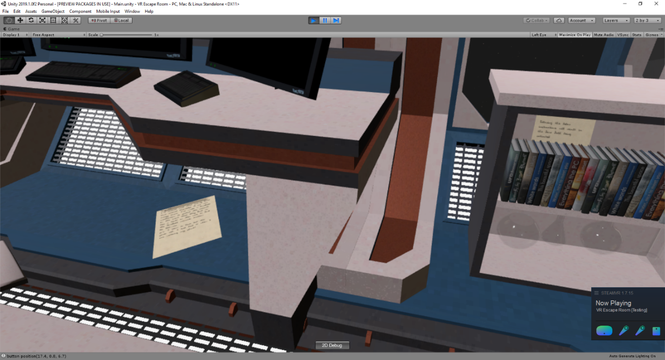
Room 1:
Notes:
Begins with audio of a scientist explaining that the player needs to protect her research from invading bugs (aliens)
And guiding the player to the first room of the spaceship, where they learn the basic theory of if statements
And then instantly apply this knowledge to complete puzzles

Slide 10
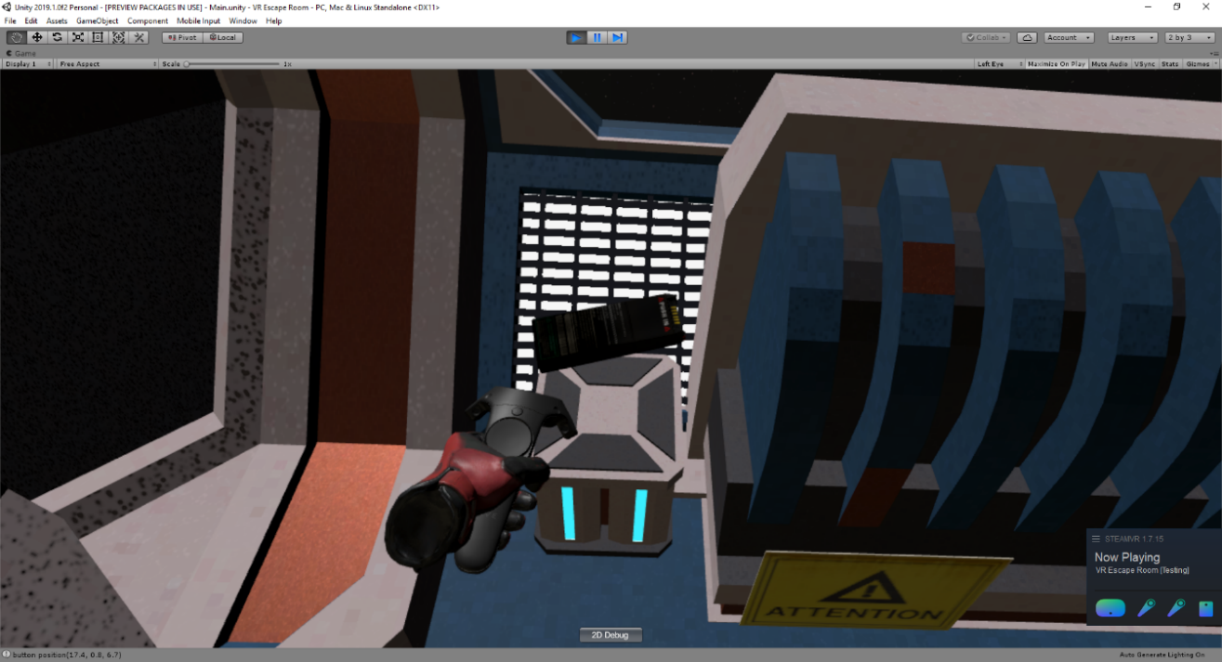
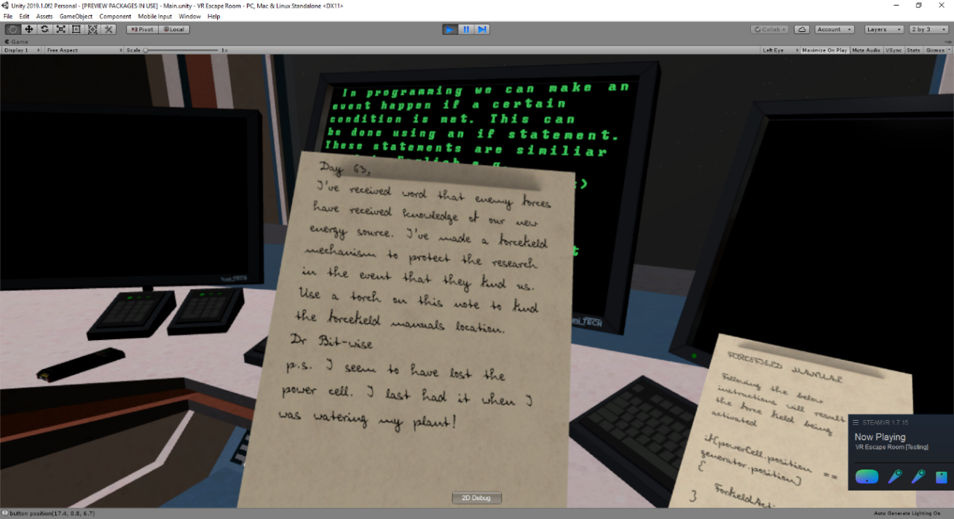
Room 1:
Notes:
If statements – why we used ifs first, how it was executed well.
Filled this rooms with some cool, exciting puzzles – user had to find a torch that reveals invisible ink, find a key etc
Gave a foundation for the users learning

Slide 11
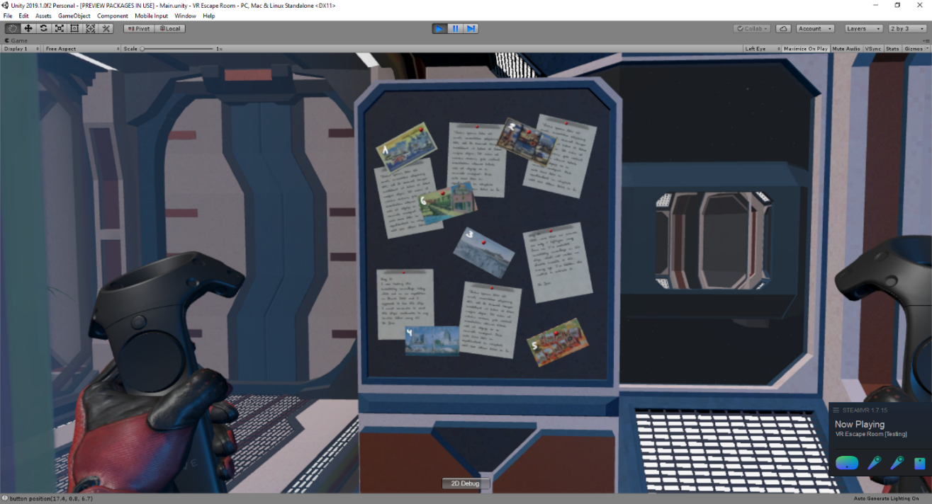
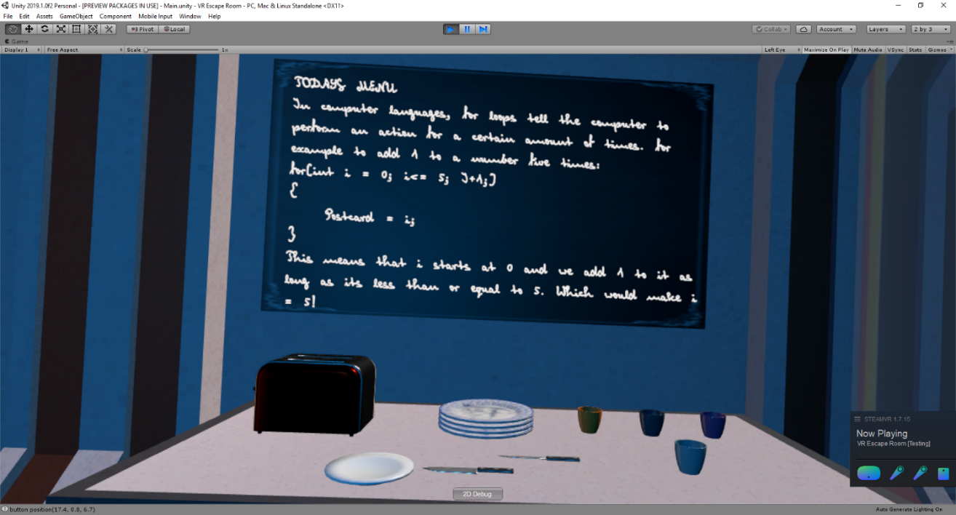
Room 2:
Notes:
After completing room 1, the scientist tells the player to go to room 2 where they must complete a series of tasks
To wrap the ship in an invisibility cloak
Player learns for loops and has to apply this
Builds on foundation learnt in first room

Slide 12
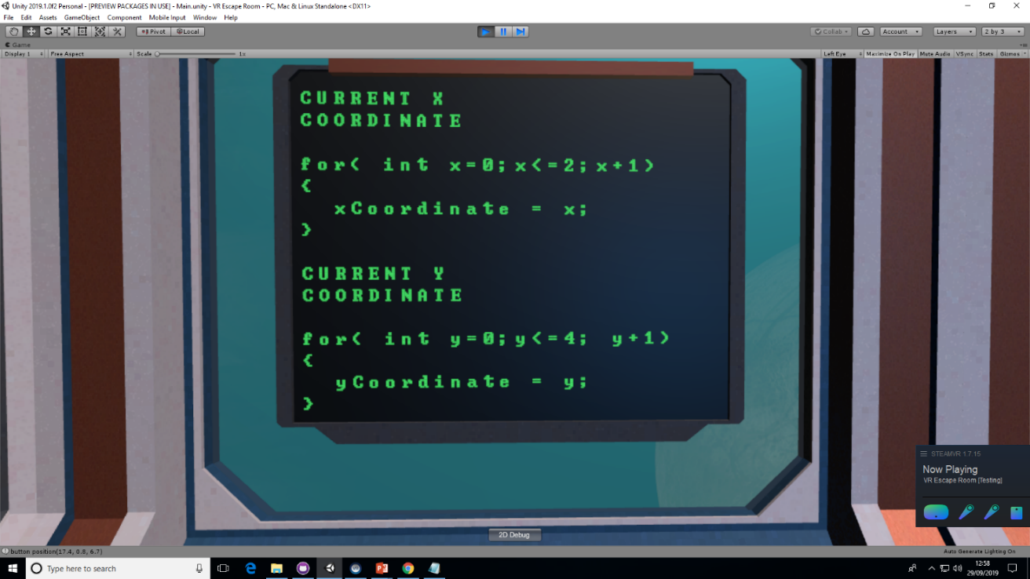
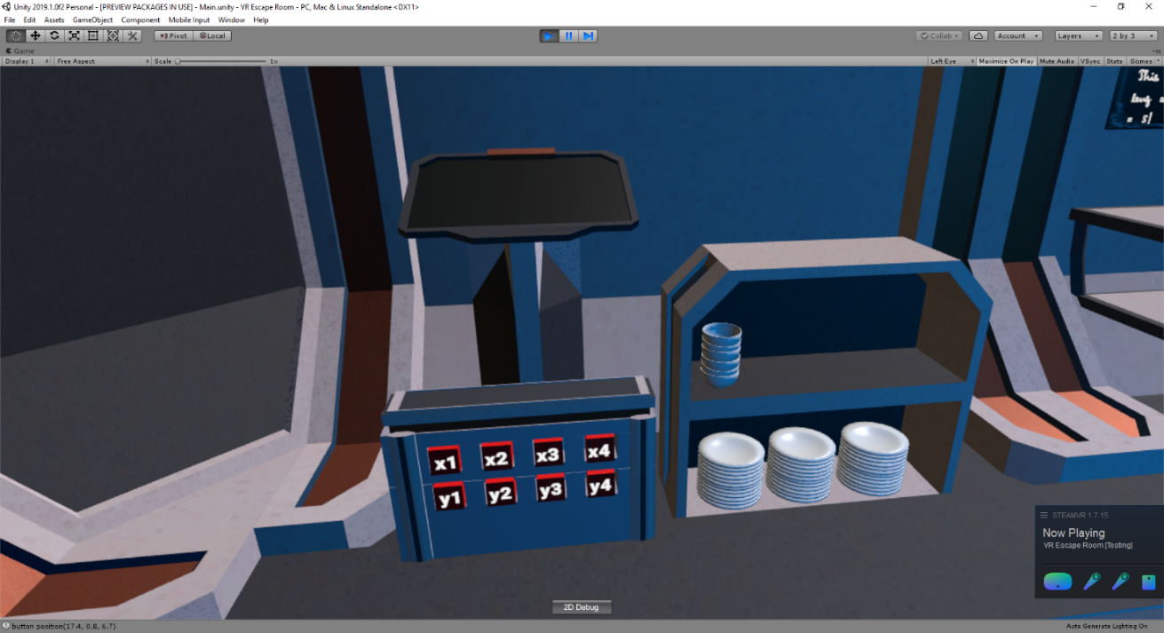
Room 2:
Notes:
Builds on foundation learnt in first room. Needs knowledge of if statements alongside the for loop

Slide 13
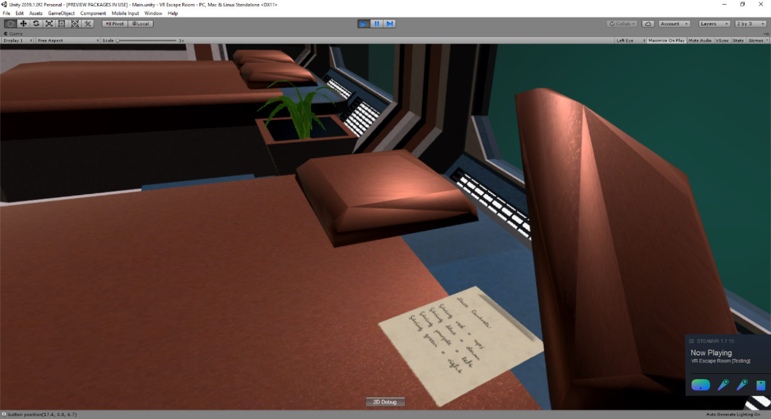
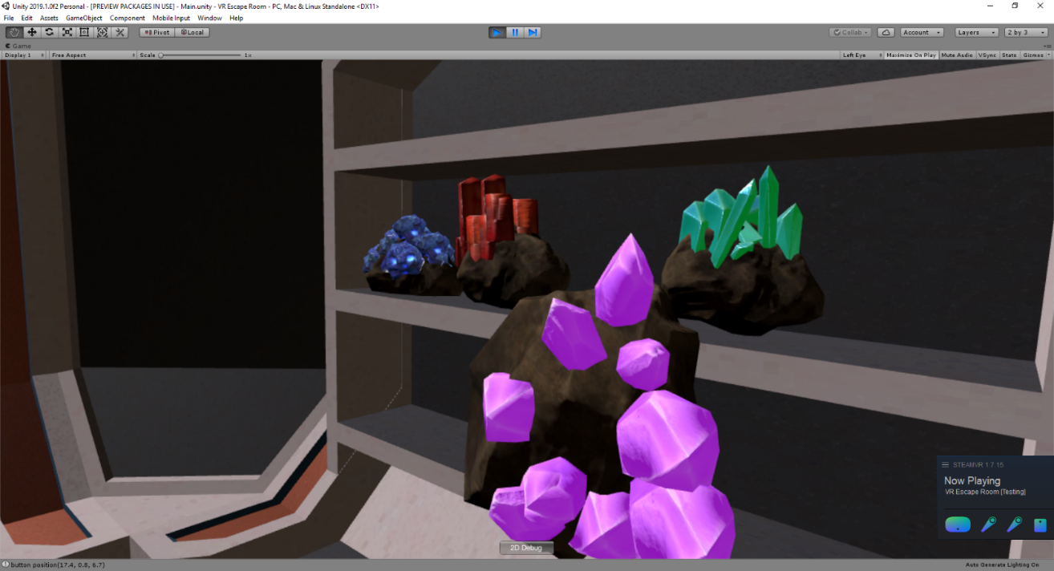
Room 3:
Notes:
Safe & maze developed in blendr.

Slide 14
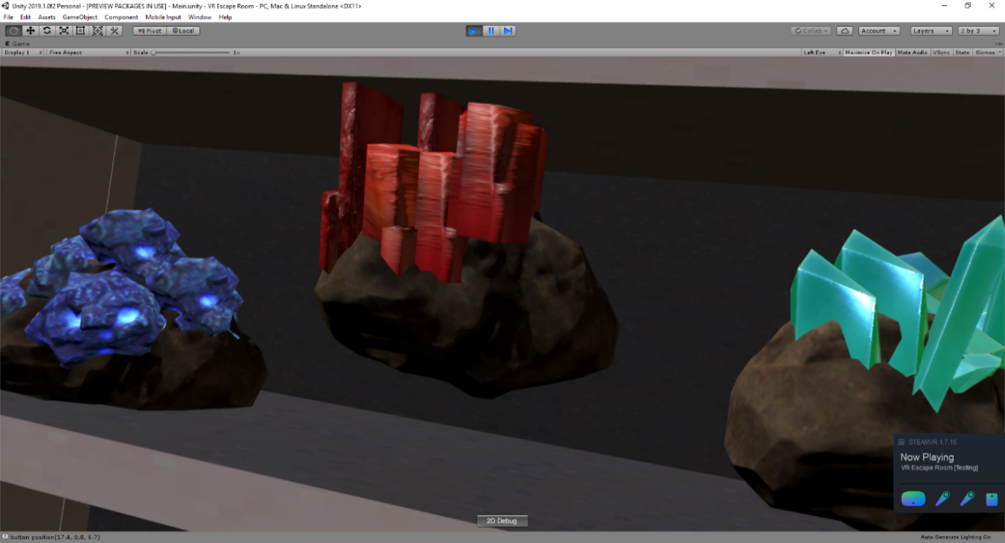
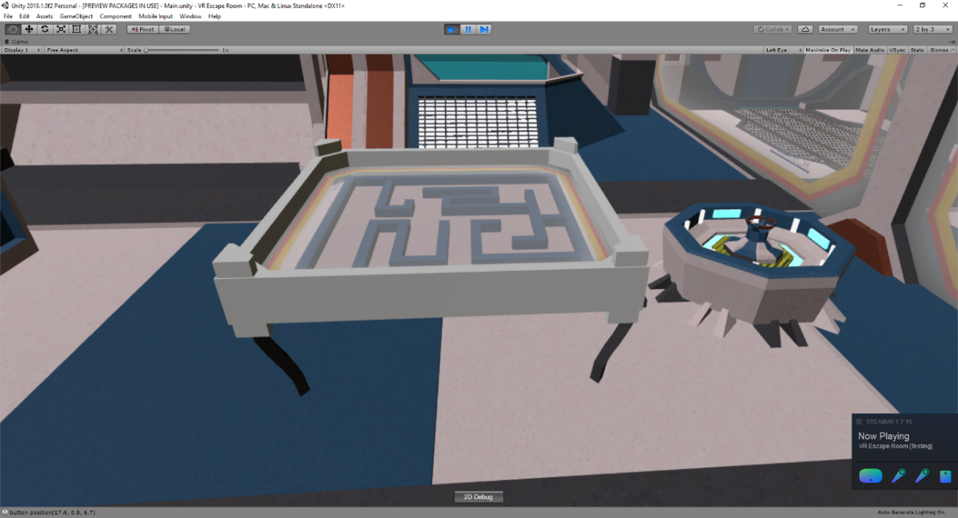
Room 3:
Notes:
Bedroom
Gems as variables.
Yeet jems at console, magic shaky shake

Slide 15
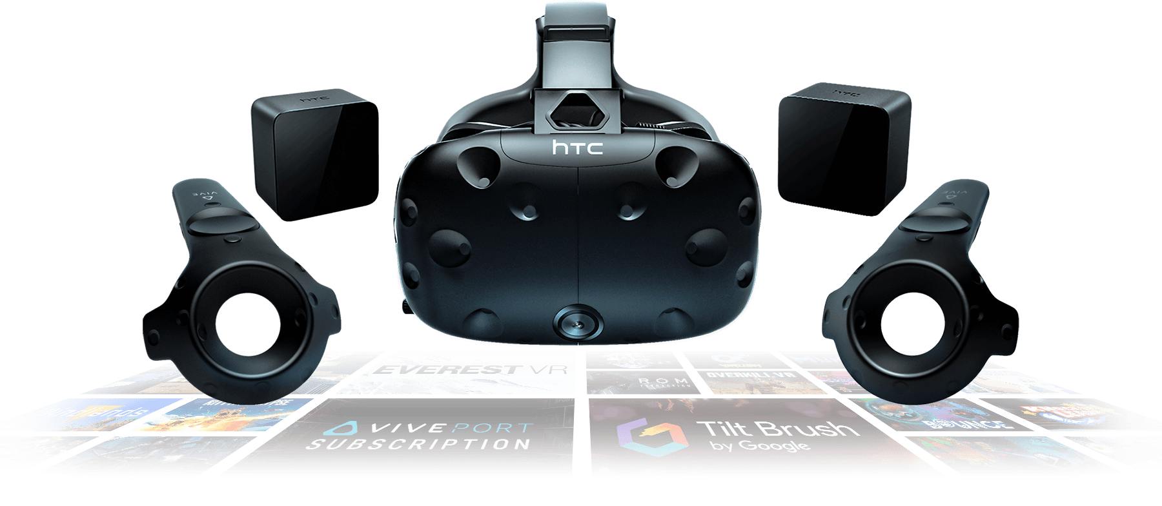
Challenges Faced:
Notes:
Tested the game ourselves every week as part of our agile methodology
Allowed us to identify bugs quickly
Not just bugs, found parts of the game that worked but wanted to improve

Slide 16
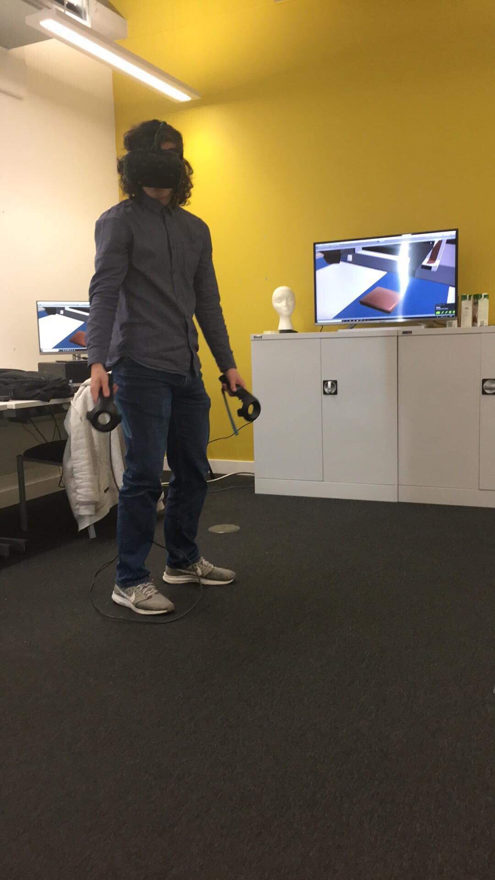
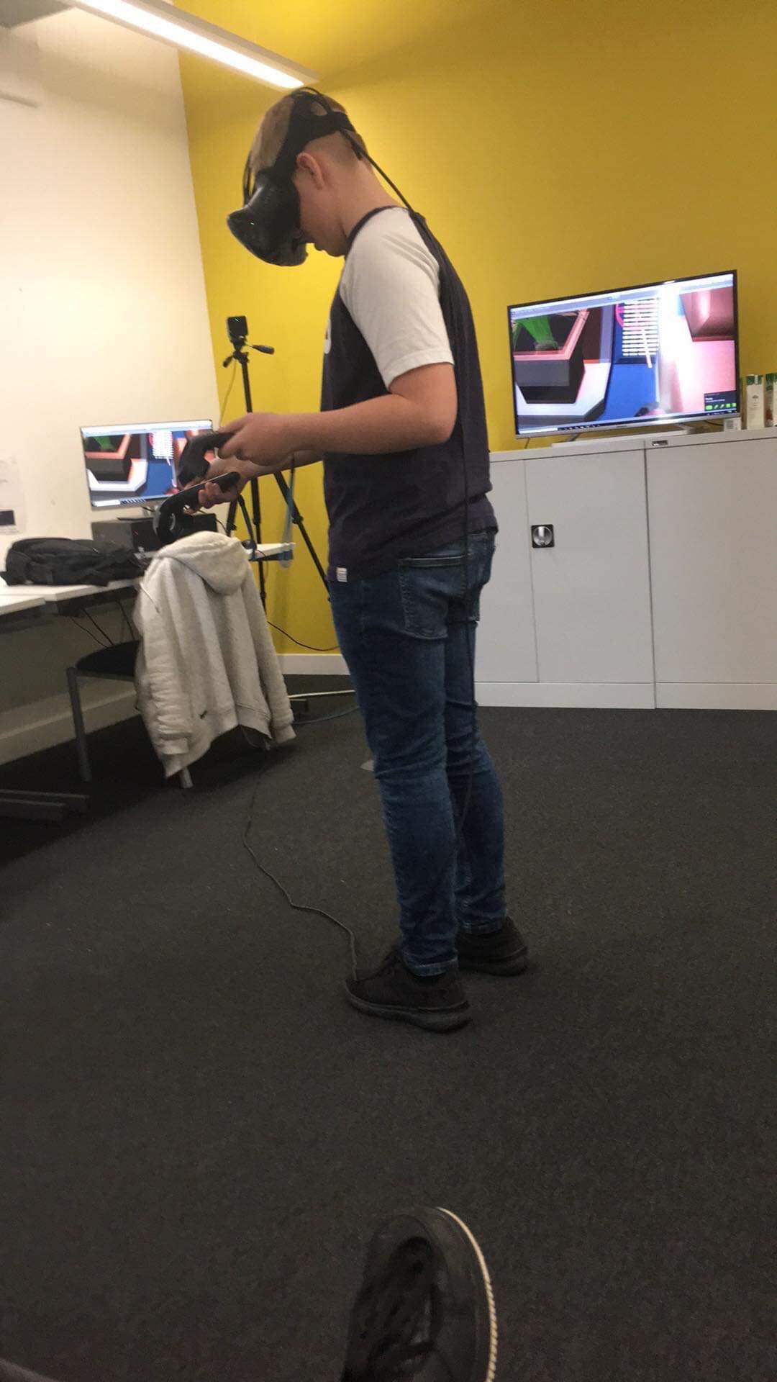
Testing:
Notes:
Also tested on our friends, family members are most importantly are user base –ks3 students
Got James’s cousins to play the game and they gave us some pointers of what worked really well

Slide 17
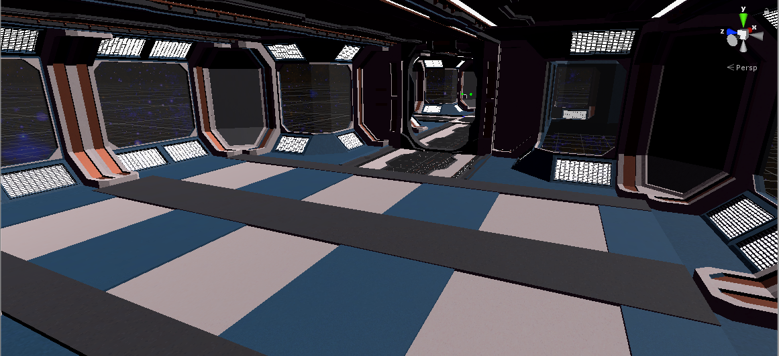
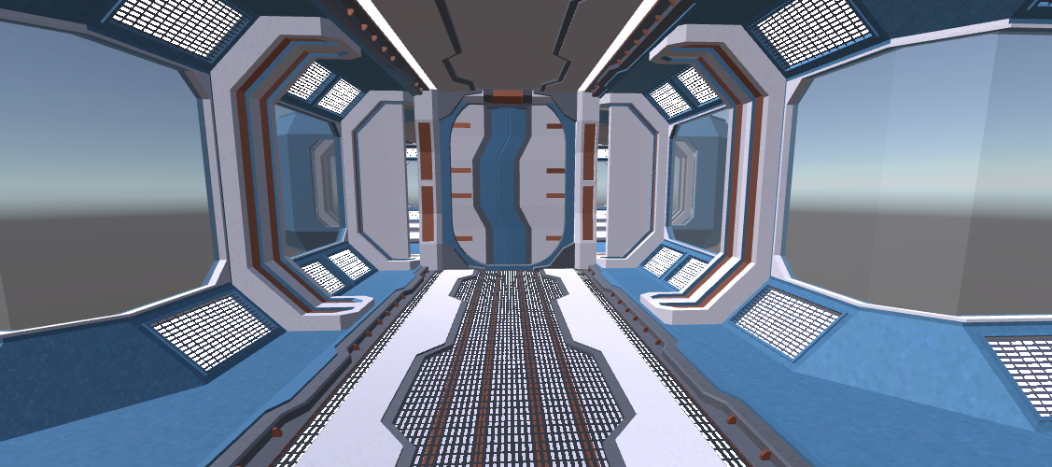
Potential Game Expansion:
Notes:
We could add more rooms for more concepts and more levels for more intermediate and advances programming concepts, increasing difficulty
-this escape rooms ends with player taking escape pod – next level could start with them crashed on a planet, finding parts to build a spaceship/escape off the planet?

Slide 18


Potential Game Expansion:
Notes:
Introduce other languages – we’ve chosen java for our game, but could be done in any programming language.
Different themes – we chose space because it appeals to wide audience, but could make it so the player can choose what map they went to learn on,
e.g. a jungle or a pyramid..

Slide 19
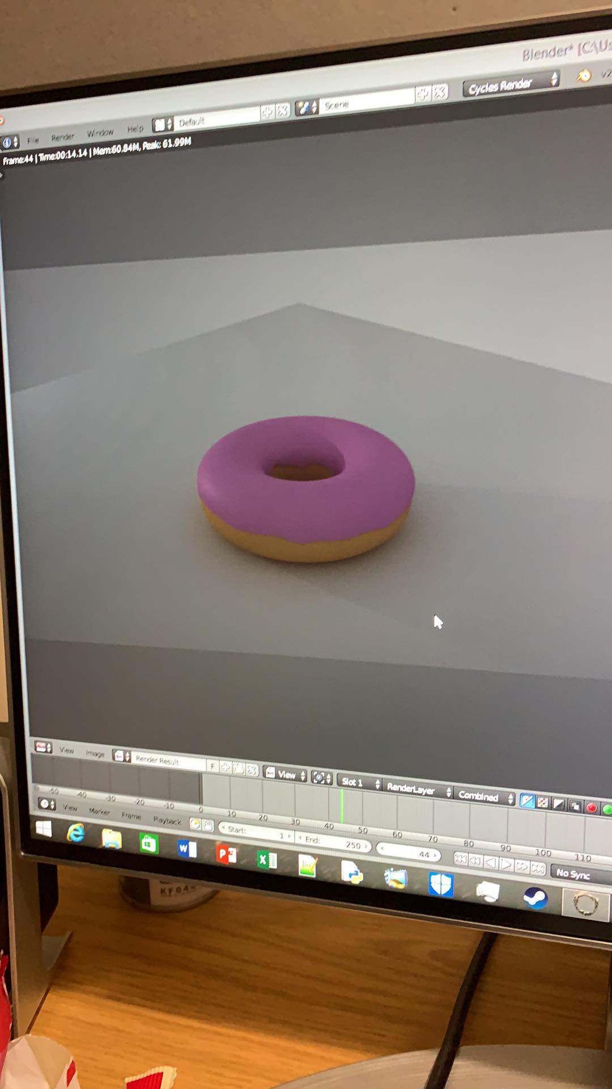
Potential Game Expansion:
Notes:
Adding more homemade assets and voice acting. Introducing more computing ideas such as basic hardware of a computer.

Slide 20
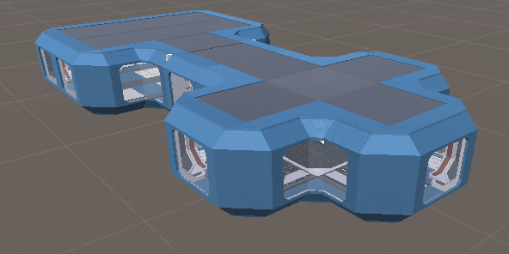
Potential Game Expansion:
Notes:
Adding more homemade assets and voice acting. Introducing more computing ideas such as basic hardware of a computer.

Slide 21

Questions:

